Slide 1
SNA HW1 Multi-Party Influence Maximization Game
2014/10/2

Slide 2
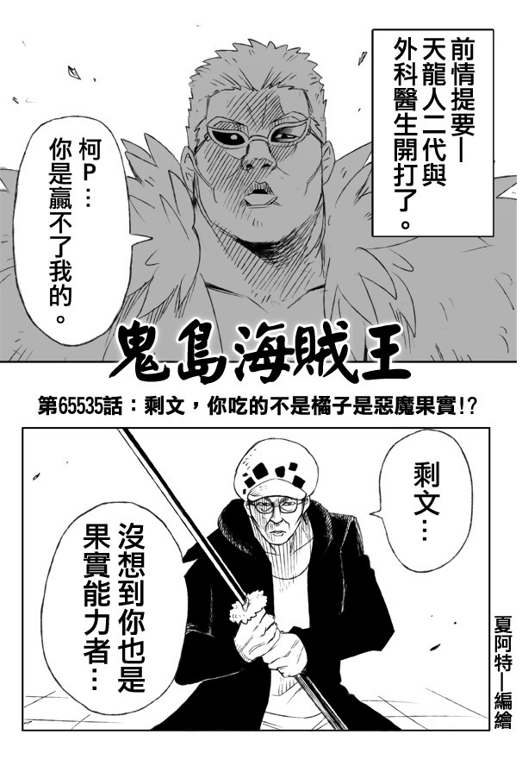
Scenario
Now you are one of the candidates of the mayor. Try your best to persuade the people to be your supporters.
The voters can vote for only one candidate
The voters try to persuade their social neighbors

Slide 3
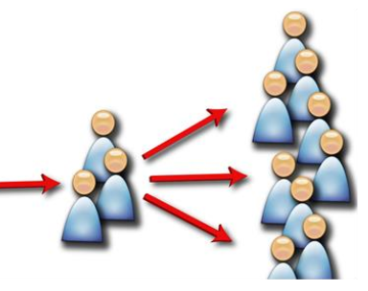
Influence Maximization Game
Your competitor select
N nodes first
Your competitor select
N nodes first
…
Propagate the
information
You select
N nodes later
Round 1
You select
N nodes later

Slide 4
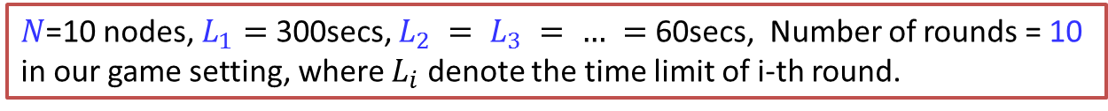
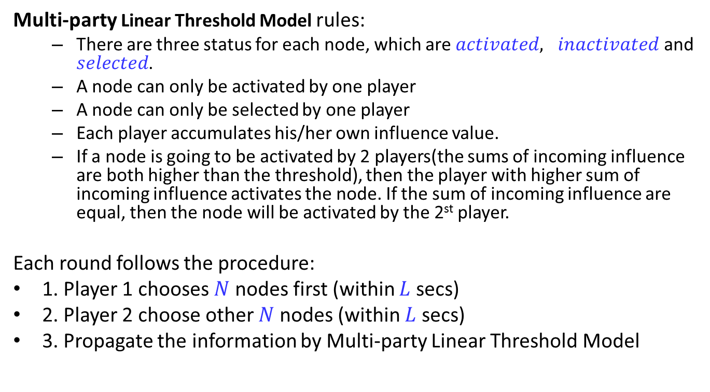
Game Rule
Multi-party Linear Threshold Model rules:
There are three status for each node, which are $activated, inactivated$ and $selected$.
A node can only be activated by one player
A node can only be selected by one player
Each player accumulates his/her own influence value.
If a node is going to be activated by 2 players(the sums of incoming influence are both higher than the threshold), then the player with higher sum of incoming influence activates the node. If the sum of incoming influence are equal, then the node will be activated by the 2st player.
Each round follows the procedure:
1. Player 1 chooses $N$ nodes first (within $L$ secs)
2. Player 2 choose other $N$ nodes (within $L$ secs)
3. Propagate the information by Multi-party Linear Threshold Model
$N$=10 nodes, $L_{1}=$ 300secs, $L_{2} = L_{3} = … =$ 60secs, Number of rounds = 10
in our game setting, where $L_{i}$denote the time limit of i-th round.

Slide 5
Your competitor strategies
We’ll implement 2 heuristic strategies as your competitors.
(S1)Max_weight
(S2)Greedy
(S3) You will need to compete with your classmates

Slide 6
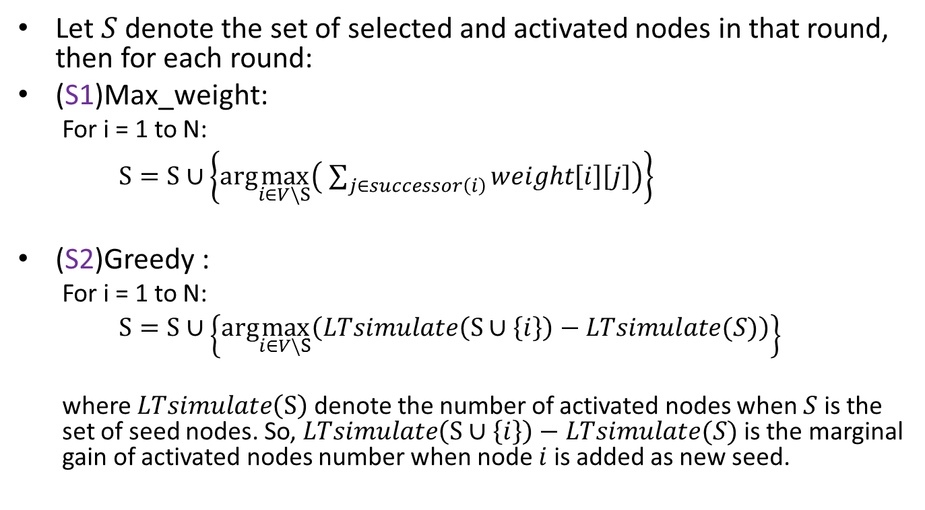
Fixed strategies (S1 and S2)
Let $S$ denote the set of selected and activated nodes in that round, then for each round:
(S1)Max_weight:
For i = 1 to N:
$S=S∪\left\{arg\max_{i∈V\backslash S}\left( \sum_{j∈successor\left(i\right)}{weight\left[i\right]\left[j\right]}\right)\right\}$
(S2)Greedy :
For i = 1 to N:
$S=S∪\left\{arg\max_{i∈V\backslash S}\left(LTsimulate\left(S∪\left\{i\right\}\right)−LTsimulate(S)\right)\right\}$
where $LTsimulate\left(S\right)$ denote the number of activated nodes when $S$ is the set of seed nodes. So, $LTsimulate\left(S∪\left\{i\right\}\right)−LTsimulate(S)$ is the marginal gain of activated nodes number when node $i$ is added as new seed.

Slide 7
Requirements
For (S1) and (S2)
Player 1: Computer using the two strategies
Player 2: Your strategies
You only have to design strategies of player 2
For (S3)
Player 1: Strategies from other groups in this class
Player 2: Your strategies
You can design strategies for player 1 and 2 respectively
Only your player 2 results will be counted in this assignment
However, since the final score depends on the ‘relative score’ among students rather than ‘absolute score’, your player 1 strategy might indirectly affect the final score

Slide 8
Process (for S1 and S2)
Main
procedure
S1 or S2
S1 or S2
egofb_lt_nodes.txt
selected_nodes.txt
selected_nodes.txt
game_status.txt
game_status.txt
Your strategy
Your strategy
egofb_lt_edges.txt

Slide 9
Process (for S3 - pairwise competing)
Player 1’s
strategy
Player 1’s
strategy
egofb_lt_nodes.txt
game_status.txt
selected_nodes.txt
selected_nodes.txt
Main
procedure
game_status.txt
game_status.txt
selected_nodes.txt
...
Player 2’s
strategy
egofb_lt_edges.txt

Slide 10
Input / Output
Input:
Player id (indicates that you are player 1 or player 2)
Social network(nodes file, edges file)
Game status
Number of selected nodes per round
Time Limitation per round
Output
A list of nodes selected by your strategy in this round

Slide 11
Input File Format(1)
Two social network hepth and egofb
Format of “egofb_lt_nodes.txt”, ”hepth_lt_nodes.txt”: each line consists of one node id and its threshold
# node_id lt_threshold
node_id1 lt_threshold
node_id2 lt_threshold
…
…

Slide 12
Input File Format(2)
Format of “egofb_lt_edges.txt”, “hepth_lt_edges.txt”: each line consists of one edge.
# Directed
# from_node_id to_node_id lt_influence
node_id1 node_id2 lt_influence
node_id3 node_id4 lt_influence
…
…

Slide 13
Input File format(3-1)
Format of the “game_status.txt”: records the log for every turn.
the nodes player_1 picked in 1st round
the nodes player_2 picked in 1st round
the nodes player_1 propagated in 1st round
the nodes player_2 propagated in 1st round
the nodes player_1 picked in 2nd round
…
…
Let R denotes the number of round until now (starting from 1).
If you are player 1, there will be 4(R-1) lines.
If you are player 2, there will be 4(R-1) + 1 lines.

Slide 14
Input File format(3-2)
Example for format of the “game_status.txt” when you are player 2
Round 1:
1170,873,290
Round 2:
1170,873,290
234,345,1729
1171,874,293,292
235,346,344
33,45,78

Slide 15
Output File format
Format of the “selected_nodes.txt”:
node1 node2 node3 …

Slide 16
Programming Language
You can use any programming language.
We’ll install Networkx, igraph, JUNG in our testing environment(linux). If you use any other language or tool, please put the required files into the zip in submission.

Slide 17
Arena
TAs have implemented the arena for the influence maximization game.
main.py
main_two_player.py
DiffusionModel.py
run.sh
run_two_player.sh
Makefile
How to use it?
Install python3 & networkx on python3 first
Implement your strategy
Modify your Makefile
Execute run.sh / run_two_player.sh

Slide 18
Delivery
Three kinds of strategies to compete with S1, S2, S3 respectively.
Report (pdf)
You have to write Makefile for us to execute your strategy(for both as player1 and player2) by the following commands:
make strategy1
make strategy2
make strategy3
Notes: 意思是，我們會用make strategy1~3去執行你的策略，分別對抗S1、S2、S3，所以務必將Makefile修改好。其中，我們會傳遞參數告訴你是player1 or player2。詳細格式請直接參照Makefile。

Slide 19
Report
The strategies you design
The experiments of all the strategies you conduct and explain why you pick it as the best strategy
Any comment on this homework
Up to 4 A4-size pages
pdf format
File name: report.pdf

Slide 20
Grading
Performance on training networks (hepth and egofb) 40%
The threshold of nodes will be modified
Competitor: (S1) 20% (S2) 20% (S3) 60%
Performance on a testing network 40%
Your strategies will be tested in another graphs
Competitor: (S1) 20% (S2) 20% (S3) 60%
For S1 and S2, we will calculate the ‘absolute score difference between two players’ as your grade. For S3, we will only count the winning percentage of your player-2 strategy
Report: 20%

Slide 21
Notes
Homework 1 is a team(one to three persons) task.
No plagiarism.
Otherwise, you will receive F in this class
Discussion is allowed, but write your own code

Slide 22
Submission
Please upload hw1_team{team_id}.zip to ceiba before 2014/10/22 22:00 containing the following structure:
team{team_id} (folder)
Makefile
report.pdf
All source codes for the three strategies
Late policy:
we will deduct 1/3 per day, that is, 2/3 of the grade if delaying by 1~24hrs, 1/3 of grade if missing by 24~48 hrs, zero after 48 hrs.

Slide 23
Installation – Python3
Python3
download Python-3.4.1.tgz from https://www.python.org/download
tar –zxvf Python-3.4.1
cd Python-3.4.1
./configure --prefix=$HOME
make
make test
make install
vim ~/.bashrc
export PATH=$HOME/bin:$PATH
Test:
which python3
python3

Slide 24
Installation – NetworkX
setuptools
wget --no-check-certificate https://bootstrap.pypa.io/ez_setup.py -O - | python3 - --user
Networkx
Download networkx-1.9.1.tar.gz from https://pypi.python.org/pypi/networkx/
tar --zxvf networkx-1.9.1.tar.gz
cd networkx-1.9.1
python3 setup.py install --user
Test:
python3
import networkx as nx
nx.__version__

